Slide 1

Sacred Heart arts and science college perani villupuram district
Bachelor of Science
In
mathematics
Affiliated to Annamalai university chidambaram
October 2023

Slide 2
India Agriculture Crop Production
submitted by :
S.S.Rojashree -22421201012
K.Sharmila -22421201014
G.Pavithra -22421201009
C.Dayana-22421201003
Guided by :
Mrs.K.Radha

Slide 3
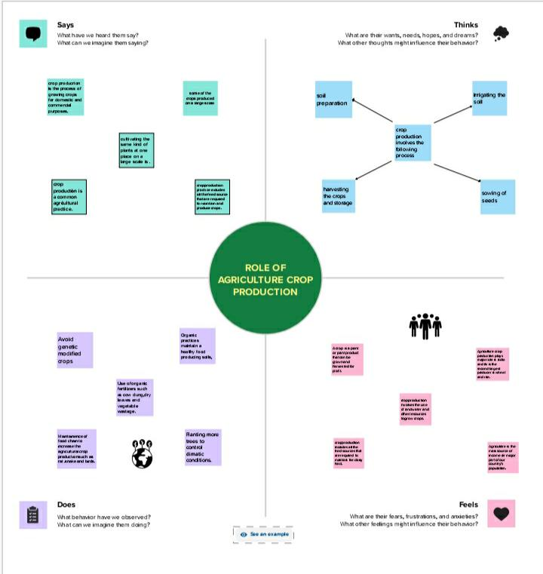
Empathy map

Slide 4

Brain Stroming

Slide 5
Insights into India’s Agricultural Crop Production
Statewide Agricultural land
Area VS Production
Season Based Cultivation by Area
Yield by season
Crop plantation by area
Major crops by growth
Season wise crop production
Crops by Plantation
Dashboard
Story

Slide 6
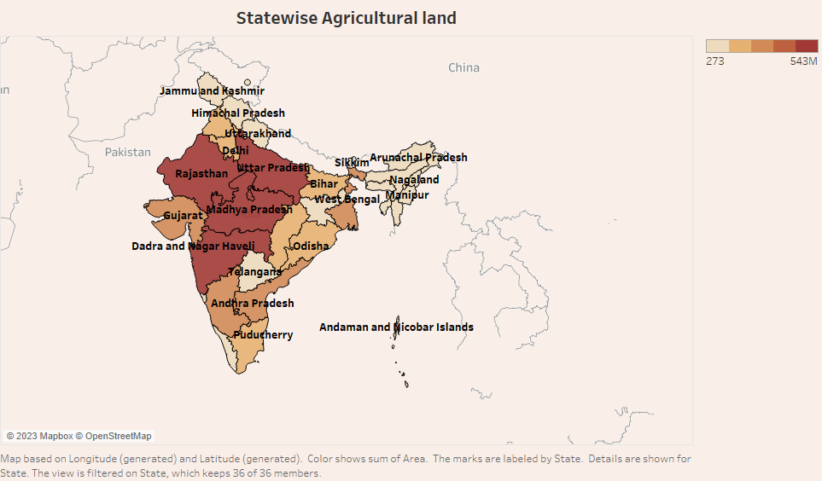

Slide 7
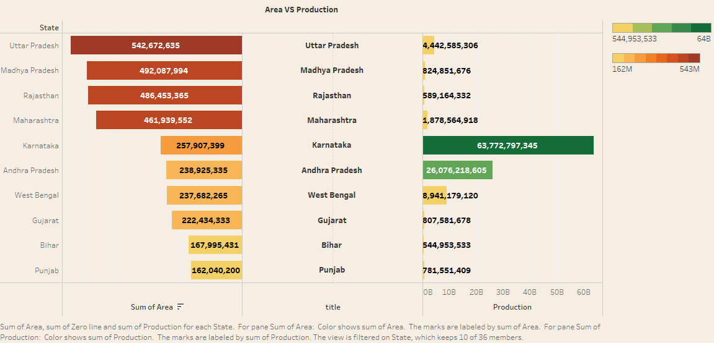

Slide 8
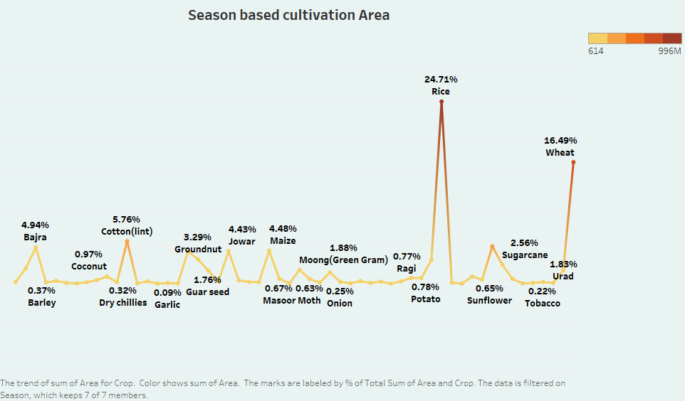

Slide 9
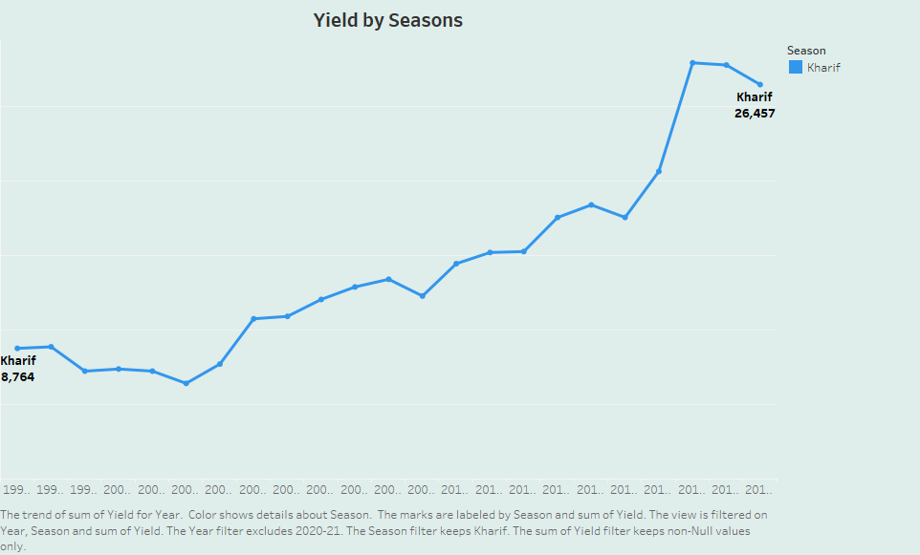

Slide 10
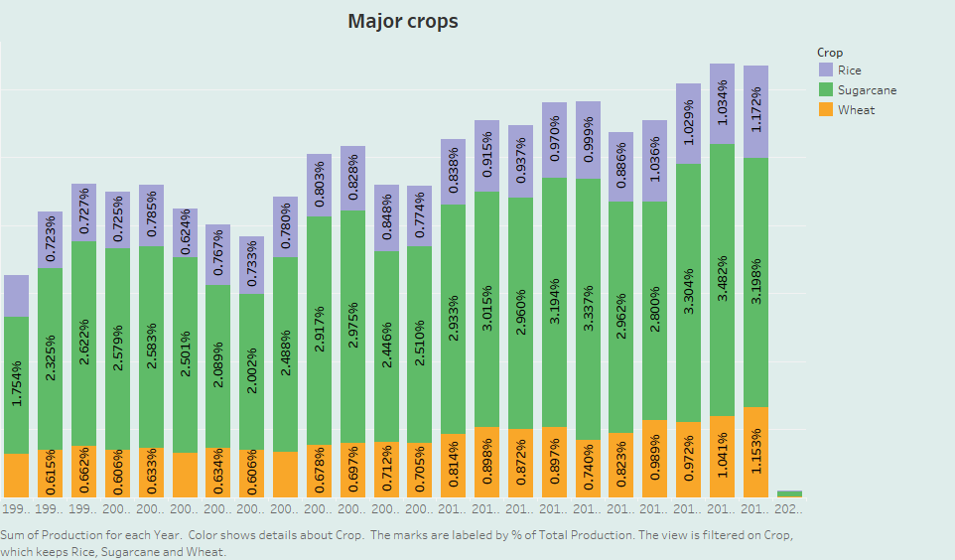

Slide 11
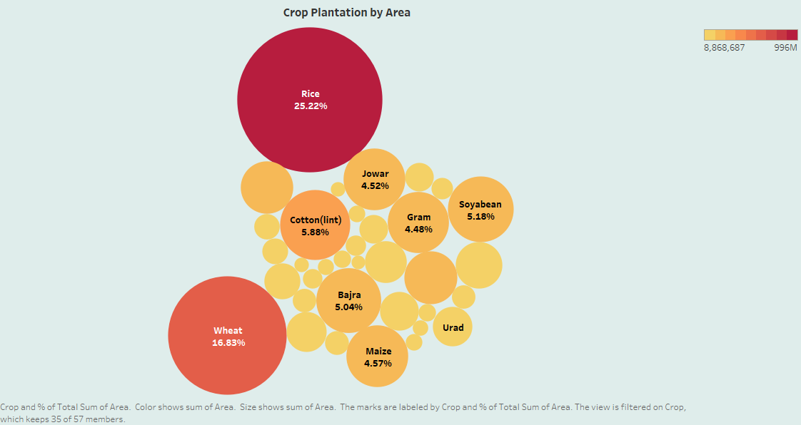

Slide 12
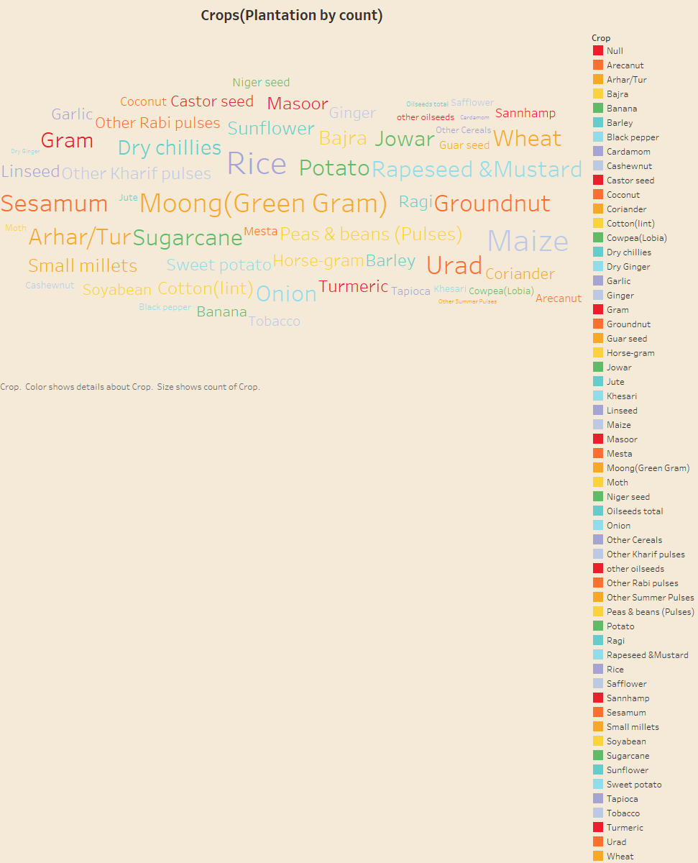

Slide 13
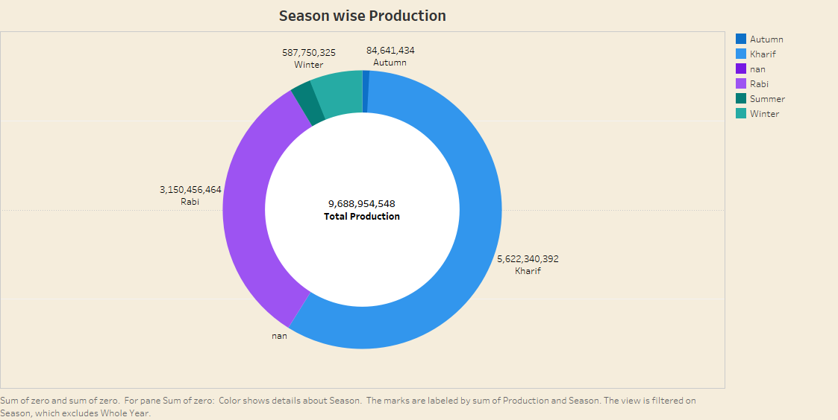

Slide 14
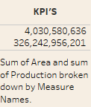

Slide 15
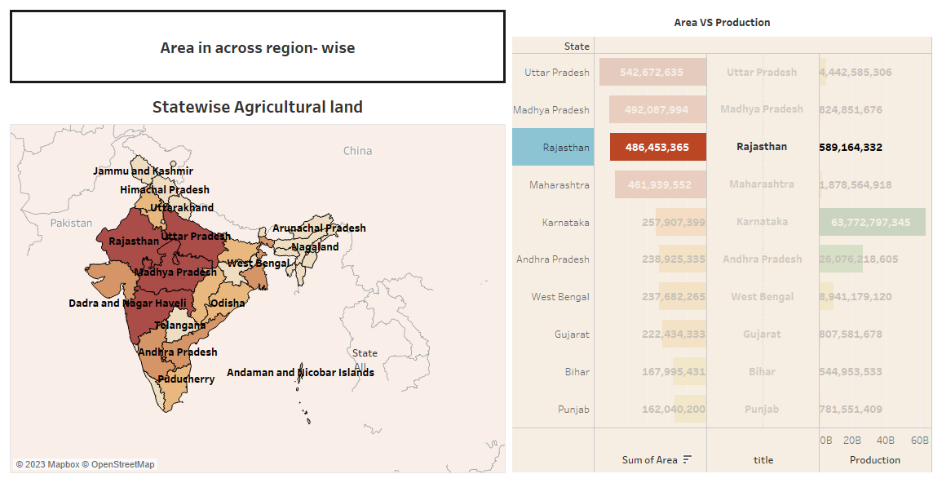

Slide 16
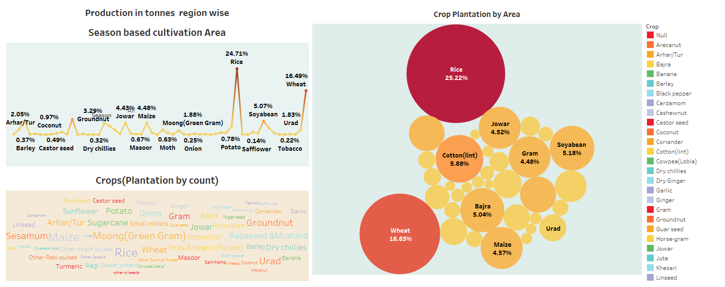

Slide 17
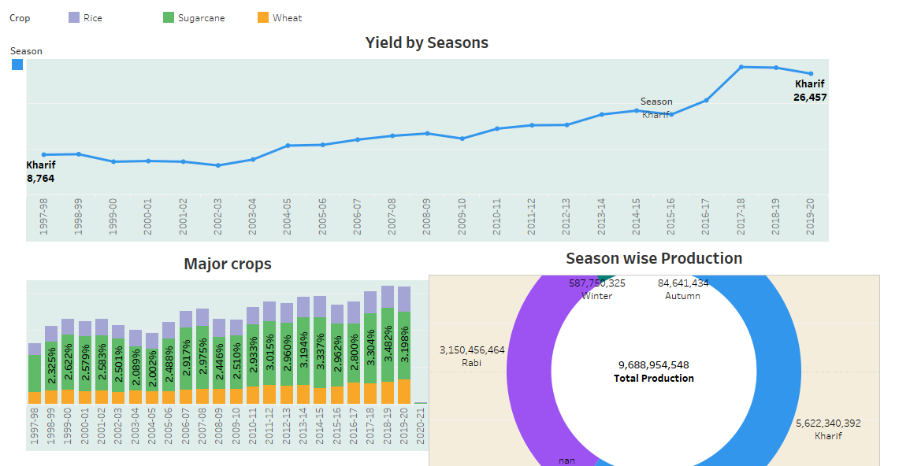

Slide 18
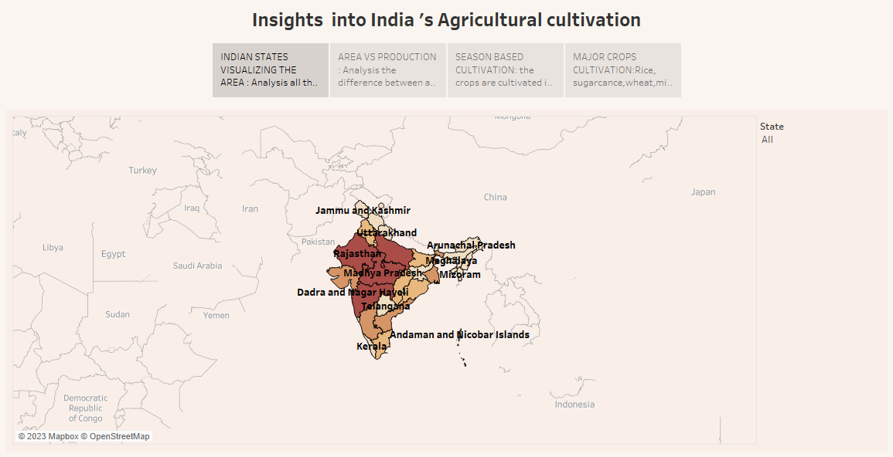

Slide 19
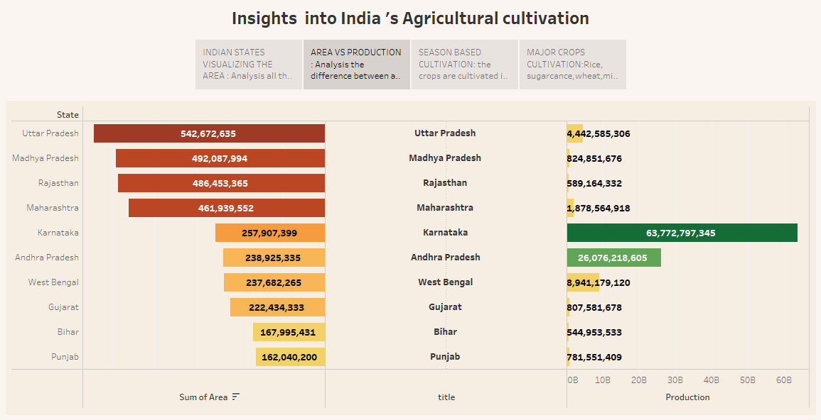

Slide 20
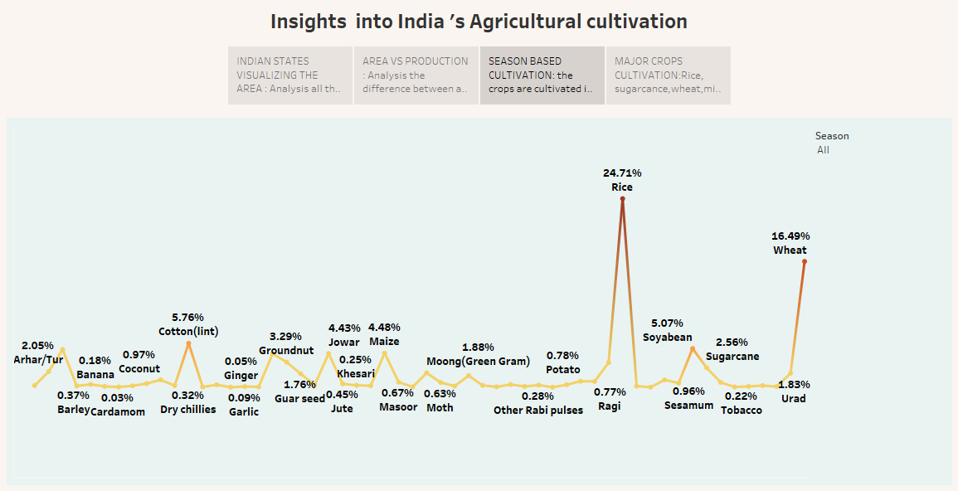

Slide 21
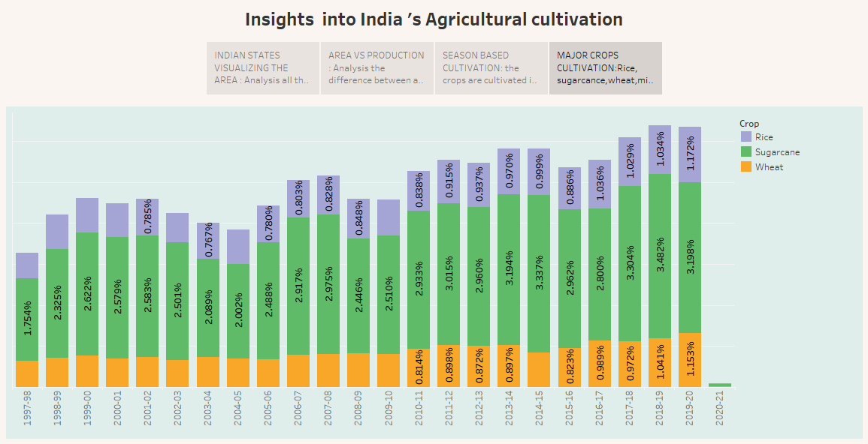

Slide 22
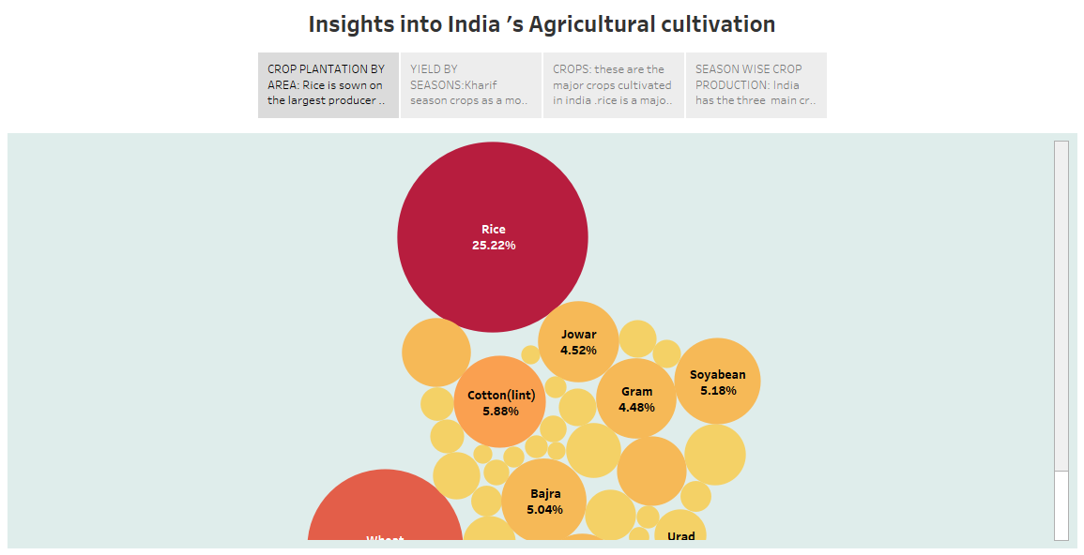

Slide 23
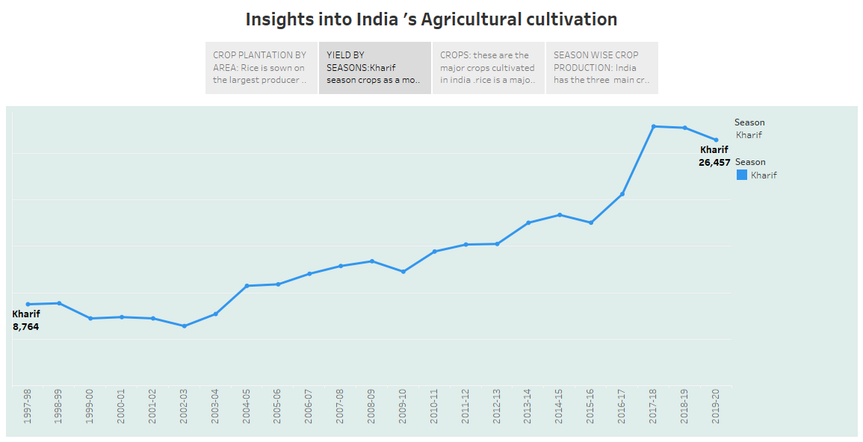

Slide 24
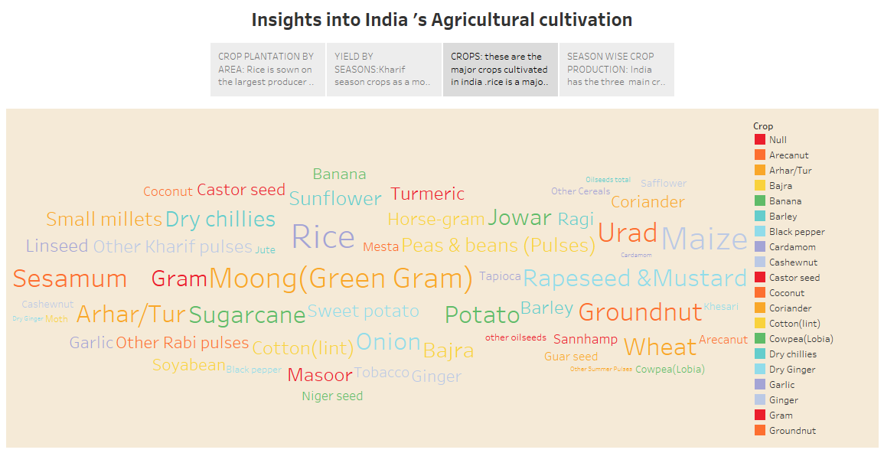

Slide 25
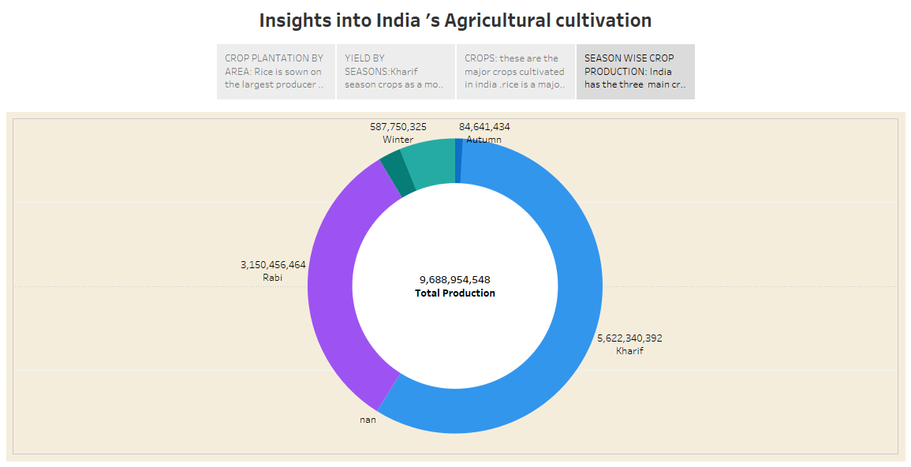

Slide 26
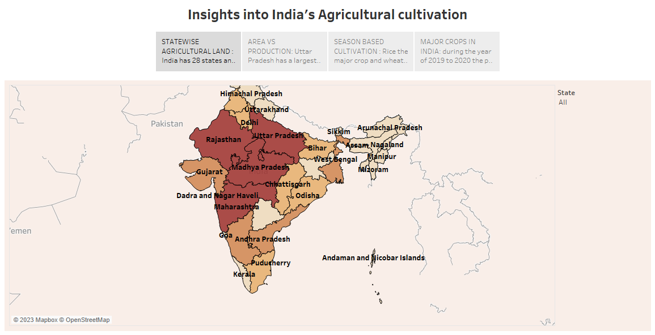

Slide 27
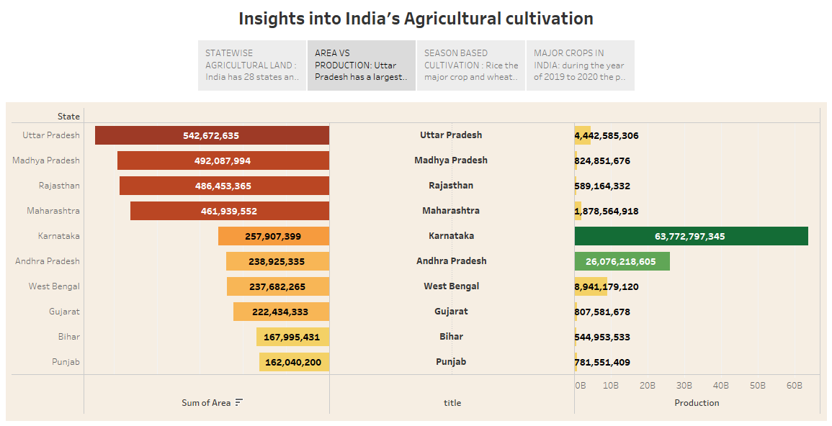

Slide 28
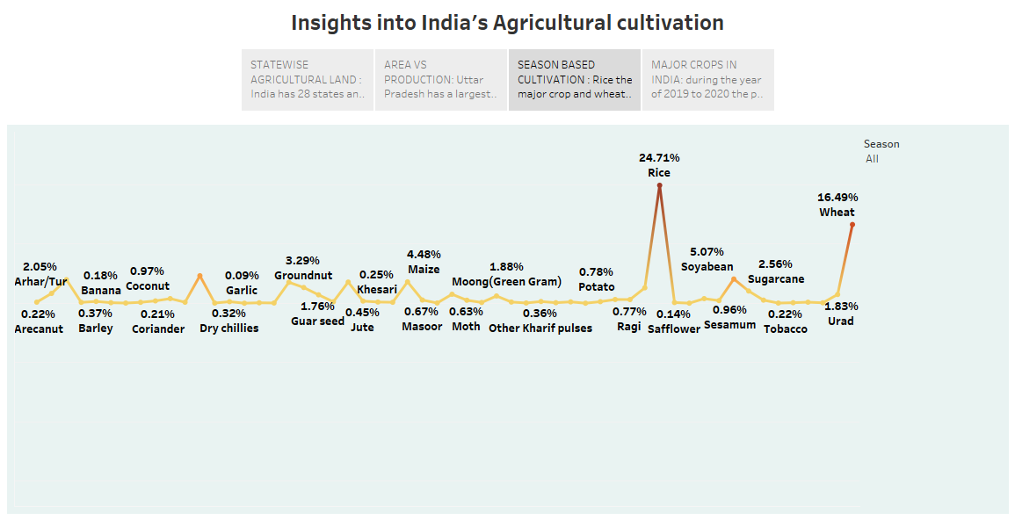

Slide 29
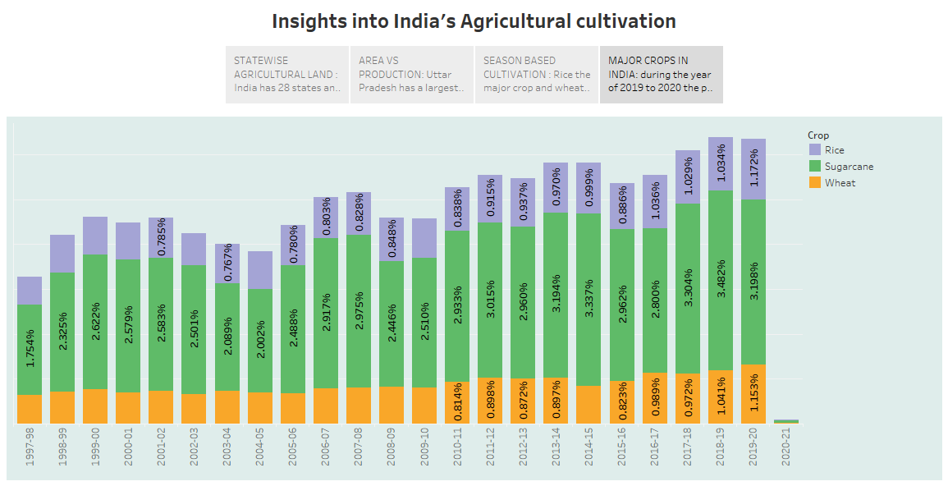

Slide 30
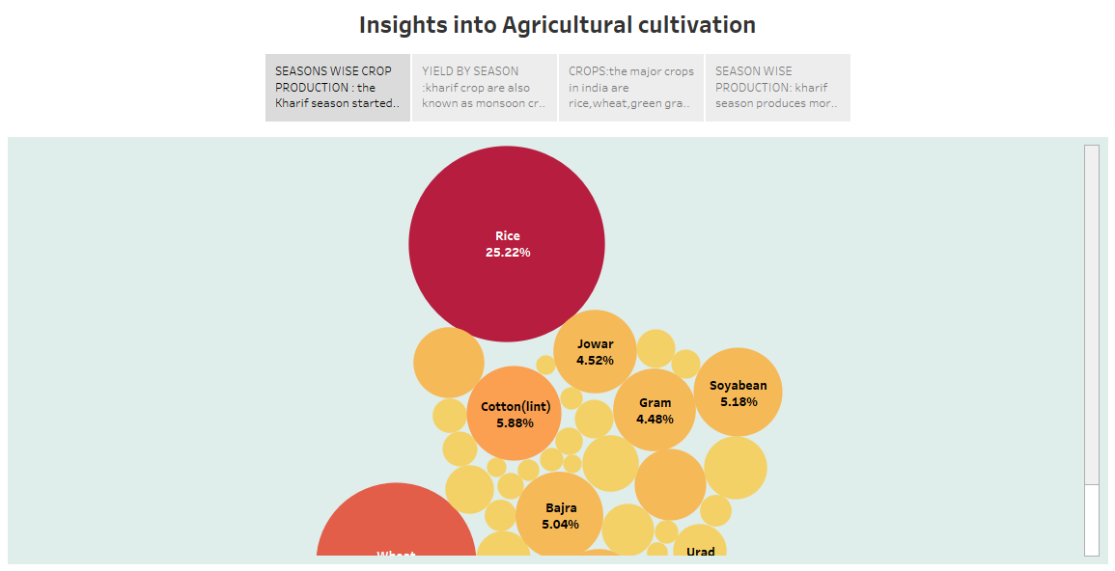

Slide 31
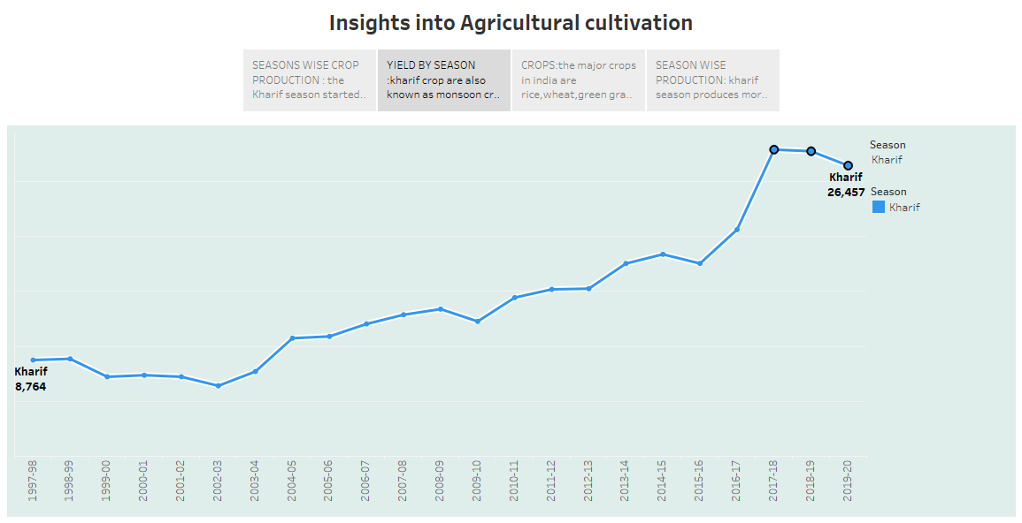

Slide 32
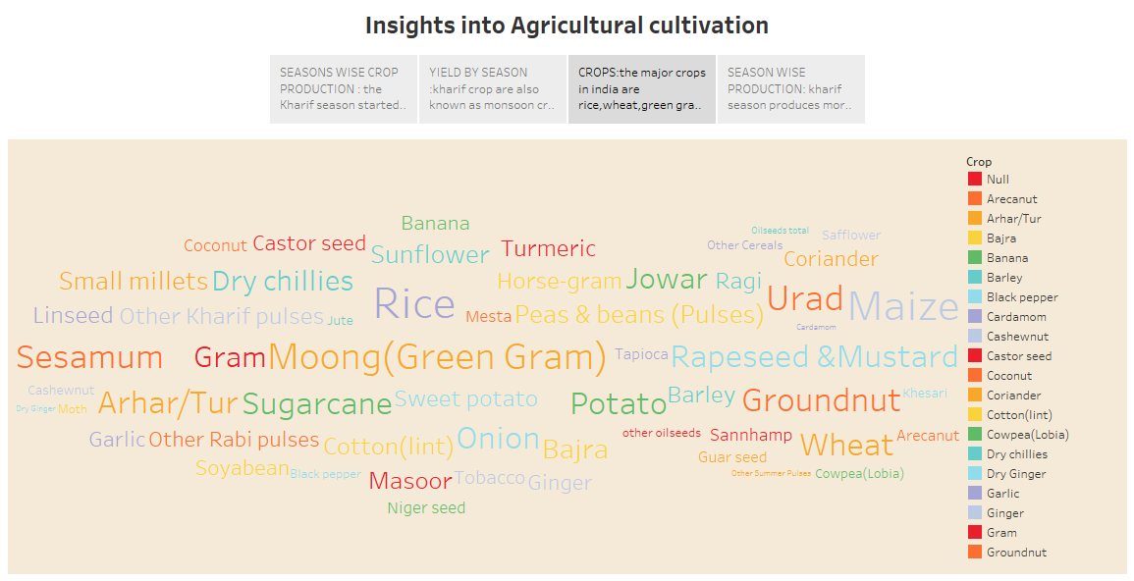

Slide 33
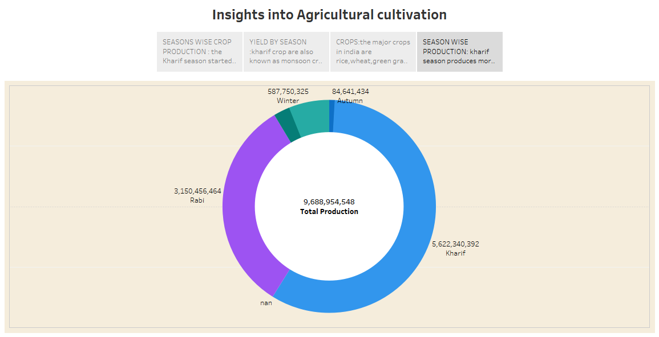

Slide 34
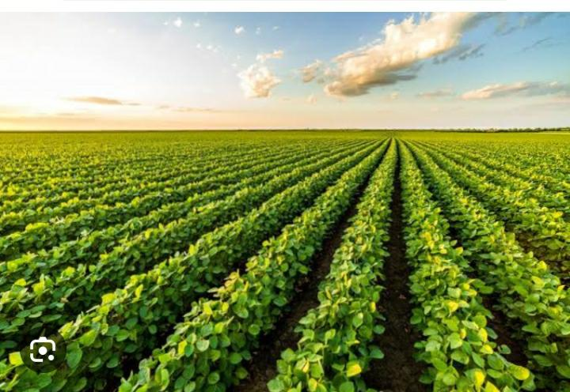
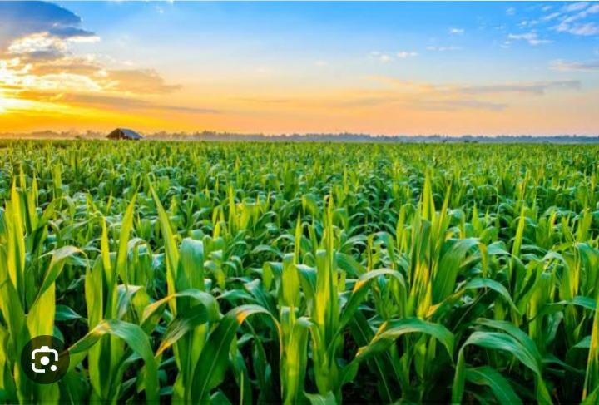
Thank you

